Slide 1
Chapter 4: Continuous Random variables and Probability Distributions
4.1 Probability Density Functions
4.2 Cumulative Distribution Functions and Expected Values
4.3 The Normal Distribution
4.4 The Exponential and Gamma Distributions
4.5 Other Continuous Distributions
4.6 Probability Plots

Slide 2
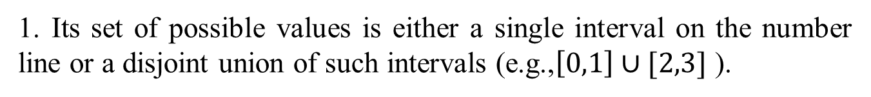
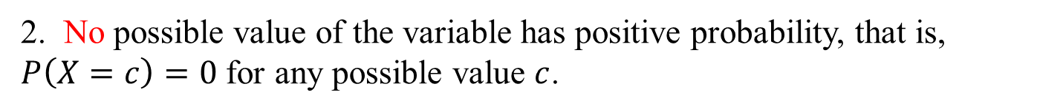
4.1 Probability Density Functions
Continuous Random Variable and Probability Distribution
A random variable is continuous if both of the following apply:
1. Its set of possible values is either a single interval on the number line or a disjoint union of such intervals (e.g.,$\left[0,1\right]∪[2,3]$ ).
2. No possible value of the variable has positive probability, that is,
$P\left(X=c\right)=0$ for any possible value $c$.

Slide 3
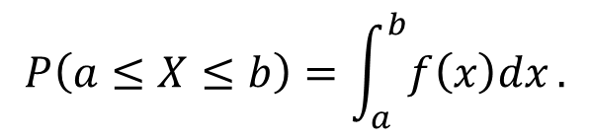
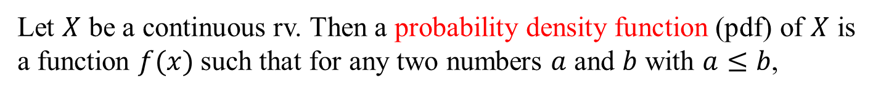
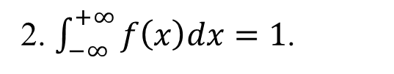
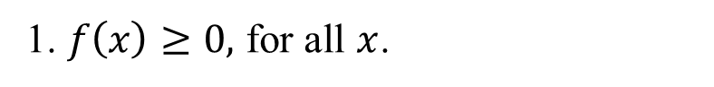
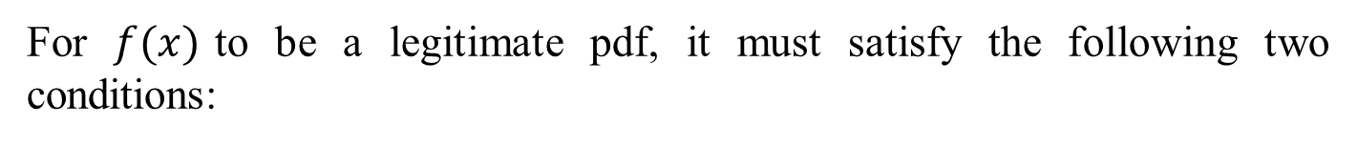
Probability Distributions for Continuous Variables
Definition
Let $X$ be a continuous rv. Then a probability density function (pdf) of $X$ is a function $f(x)$such that for any two numbers $a$ and $b$ with $a≤b$,
$$P\left(a≤X≤b\right)=\int_{a}^{b}{f\left(x\right)dx}.$$
For $f(x)$to be a legitimate pdf, it must satisfy the following two conditions:
1. $f\left(x\right)≥0,$ for all $x$.
2. $\int_{−∞}^{+∞}{f\left(x\right)dx}=1$.

Slide 4
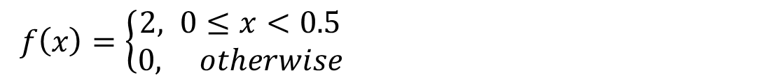

Question 1
For $f(x)$to be a legitimate pdf, is it possible $f\left(x\right)>1$ for some $x$?
Yes, it is.
$f\left(x\right)=\left\{\begin{aligned}2, 0≤x<0.5 \\ &0, otherwise\end{aligned}\right.$
$f(x)$ is nonnegative for all $x$ and $\int_{−∞}^{+∞}{f\left(x\right)dx}=\int_{0}^{0.5}{2dx}=1$.
And thus $f(x)$is a legitimate pdf.

Slide 5
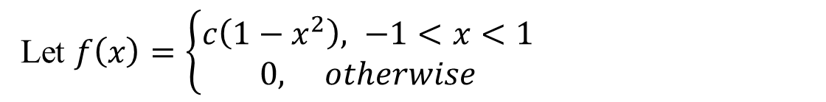
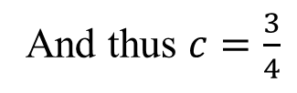
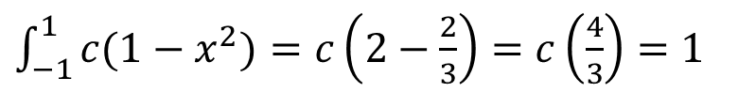
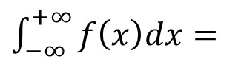

Question 2
Let $X$ be a continuous random variable with pdf
Let $f\left(x\right)=\left\{\begin{aligned}c\left(1−x^{2}\right), −1<x<1 \\ &0, otherwise\end{aligned}\right.$
What is the value of $c$?
Solution
$\int_{−∞}^{+∞}{f\left(x\right)dx}=$
$\int_{−1}^{1}{c(1−x^{2})}=c\left(2−\frac{2}{3}\right)=c\left(\frac{4}{3}\right)=1$
And thus $c=\frac{3}{4}$

Slide 6
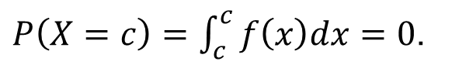

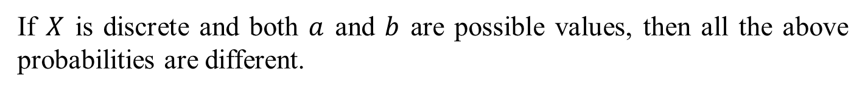
We have introduced the important role of probability mass function (pmf) for discrete random variables.
The pdf plays the same role as pmf. Once we get it, we can calculate the probability of interest.
When $X$ is a discrete rv, each possible value is assigned positive probability. However if $X$ is a continuous rv, for any real number $c$
$P\left(X=c\right)=\int_{c}^{c}{f\left(x\right)dx}=0$.
And this will result that
$P\left(a≤X≤b\right)=P\left(a<X<b\right)=P\left(a≤X<b\right)=P(a<X≤b)$.
If $X$ is discrete and both $a$ and $b$ are possible values, then all the above probabilities are different.

Slide 7
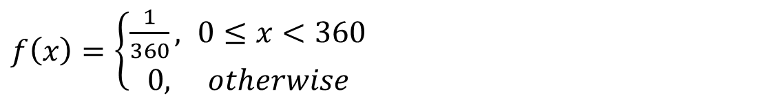
Example
Let $X$ be a continuous random variable with pdf
$f\left(x\right)=\left\{\begin{aligned}\frac{1}{360}, 0≤x<360 \\ &0, otherwise\end{aligned}\right.$
$P\left(90≤X≤180\right)=\int_{90}^{180}{f\left(x\right)dx}=\frac{1}{360}×90=\frac{1}{4}$.
$$P\left(90<X<100 or 110<X<120 \right)$$
$=P\left(90<X<100\right)+P(110<X<120)$
$=\int_{90}^{100}{\frac{1}{360}dx}+\int_{110}^{120}{\frac{1}{360}dx }=\frac{10}{360}+\frac{10}{360}=\frac{20}{360}=\frac{1}{18}$
Such a random variable is said to have a uniform distribution.

Slide 8
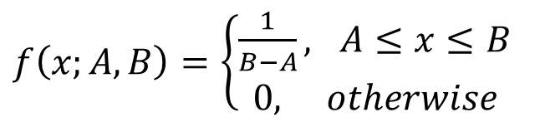
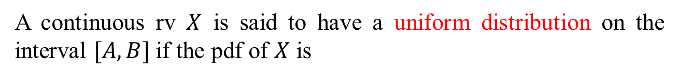
Definition
A continuous rv $X$ is said to have a uniform distribution on the interval $[A, B]$if the pdf of $X$ is
$f\left(x;A,B\right)=\left\{\begin{aligned}\frac{1}{B−A}, A≤x≤B \\ 0, otherwise\end{aligned}\right.$

Slide 9
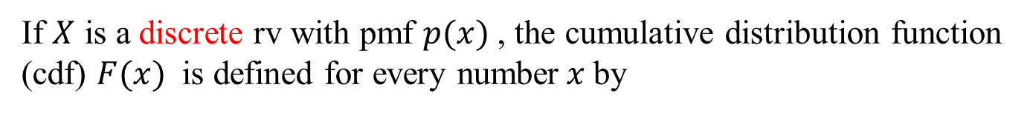

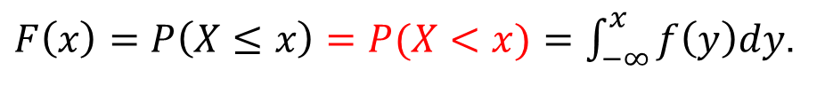
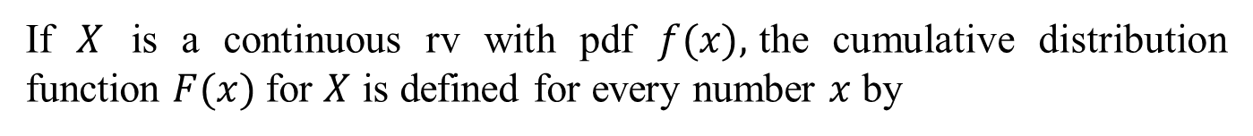
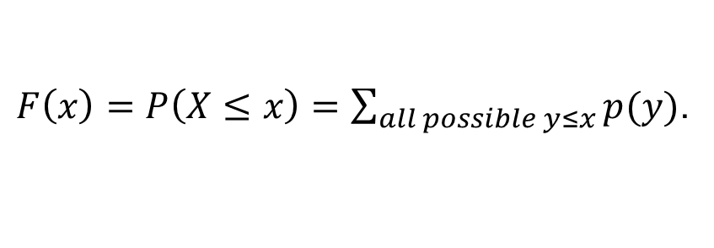
4.2 Cumulative Distribution Functions and Expected Values
The Cumulative Distribution Function
The cumulative distribution function (cdf) $F(x)$for an rv $X$ gives, for any specific number $x$, the probability $P(X≤x)$.
If $X$ is a discrete rv with pmf $p(x)$, the cumulative distribution function (cdf) $F(x)$ is defined for every number$x$by
$F\left(x\right)=P\left(X≤x\right)=\sum_{all possible y≤x}{p(y)}$.
If $X$ is a continuous rv with pdf $f(x),$the cumulative distribution function $F(x)$for $X$ is defined for every number $x$ by
$F\left(x\right)=P\left(X≤x\right)=P(X<x)=\int_{−∞}^{x}{f\left(y\right)dy}$.

Slide 10

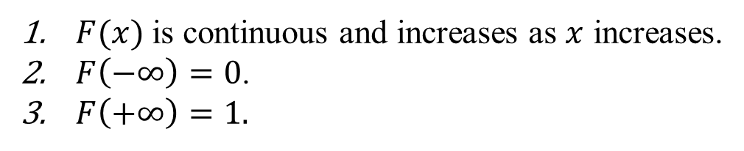
For a continuous rv, the cumulative distribution function $F(x)$ has the following properties.
$F(x)$is continuous and increases as $x$ increases.
$F\left(−∞\right)=0$.
$F\left(+∞\right)=1.$
For a continuous rv, if the pdf is available, then cdf can be derived.
This process can be reversed to obtain the pdf from the cdf whenever the latter function is available.

Slide 11
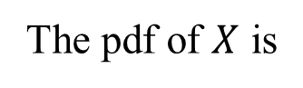
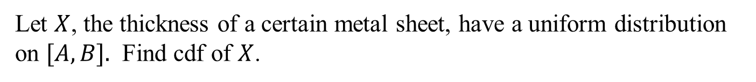
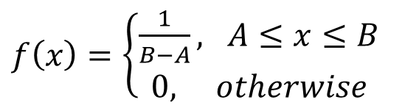
Example
Let $X$, the thickness of a certain metal sheet, have a uniform distribution on $[A, B].$ Find cdf of $X$.
Solution
The pdf of $X$ is
$f\left(x\right)=\left\{\begin{aligned}\frac{1}{B−A}, A≤x≤B \\ 0, otherwise\end{aligned}\right.$
For any $x≤A$, $F\left(x\right)=\int_{−∞}^{x}{f\left(x\right)dx}=0.$
For any $A<x≤B$, $F\left(x\right)=\int_{−∞}^{x}{f\left(x\right)dx}=\int_{A}^{x}{\frac{1}{B−A}dx}=\frac{x−A}{B−A}$
For any $x>B$, $F\left(x\right)=\int_{−∞}^{x}{f\left(x\right)dx}=\int_{A}^{B}{\frac{1}{B−A}dx}=1.$

Slide 12
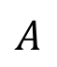
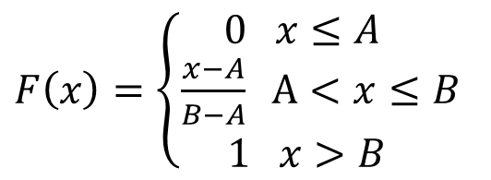
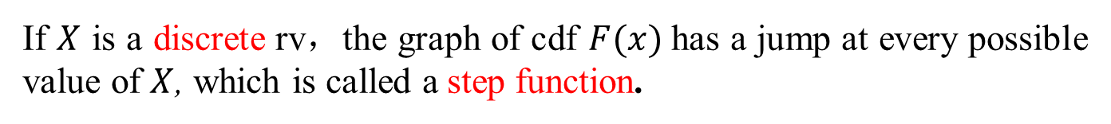

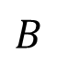
$F\left(x\right)=\left\{\begin{aligned} 0 x≤A \\ \frac{x−A}{B−A} Α<x≤B \\ 1 x>B \end{aligned}\right.$
The entire cdf is
The graph is
$$1$$
$$A$$
$$B$$
Remark
If $X$ is a discrete rv，the graph of cdf $F(x)$has a jump at every possible value of $X$, which is called a step function.
If $X$ is a continuous rv，the graph of cdf $F(x)$ is continuous.

Slide 13
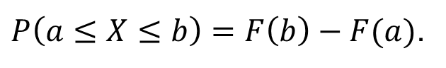

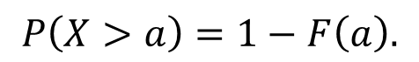
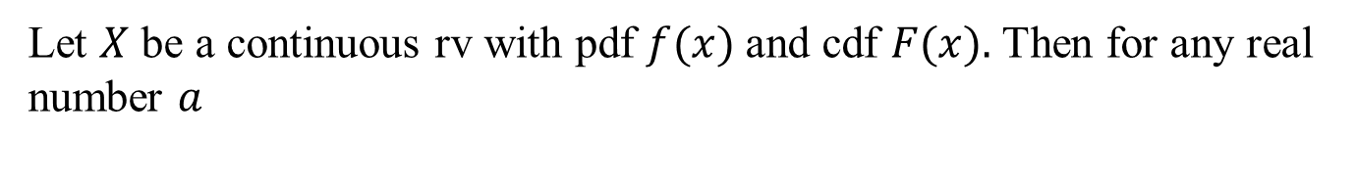
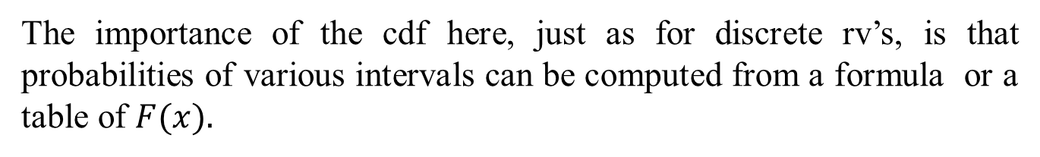
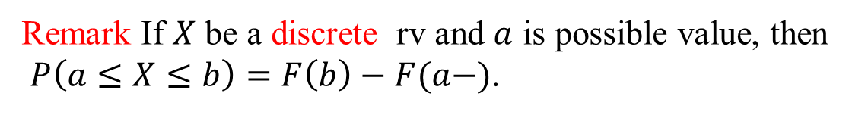
Using cdf $F(x)$ to Compute Probabilities
The importance of the cdf here, just as for discrete rv’s, is that probabilities of various intervals can be computed from a formula or a table of $F(x).$
Proposition
Let $X$ be a continuous rv with pdf $f(x)$and cdf $F(x).$Then for any real number $a$
$$P\left(X>a\right)=1−F\left(a\right).$$
And for any two numbers $a$ and $b$ with $a<b$,
$P\left(a≤X≤b\right)=F\left(b\right)−F(a)$.
Remark If $X$ be a discrete rv and $a$ is possible value, then
$P\left(a≤X≤b\right)=F\left(b\right)−F(a−)$.

Slide 14
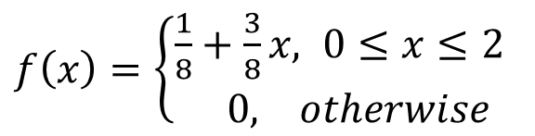

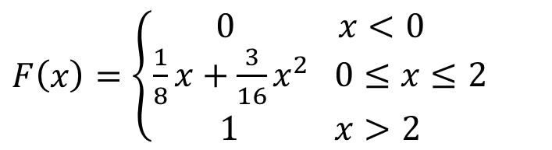
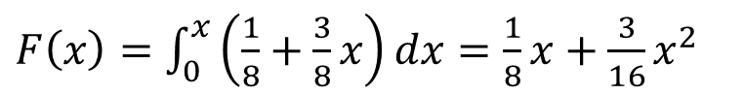
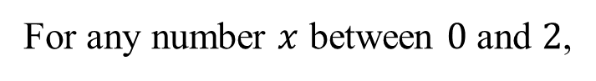
Example
Suppose the pdf of the magnitude $X$ of a dynamic load on a bridge is given by
$f\left(x\right)=\left\{\begin{aligned}\frac{1}{8}+\frac{3}{8}x, 0≤x≤2 \\ & 0, otherwise\end{aligned}\right.$
For any number $x$ between $0$ and $2$,
$F\left(x\right)=\int_{0}^{x}{\left(\frac{1}{8}+\frac{3}{8}x\right)dx}=\frac{1}{8}x+\frac{3}{16}x^{2}$
Thus
$F\left(x\right)=\left\{\begin{aligned} 0 x<0 \\ \frac{1}{8}x+\frac{3}{16}x^{2} 0≤x≤2 \\ 1 x>2 \end{aligned}\right.$

Slide 15
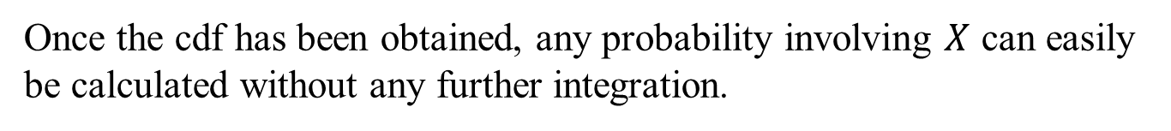
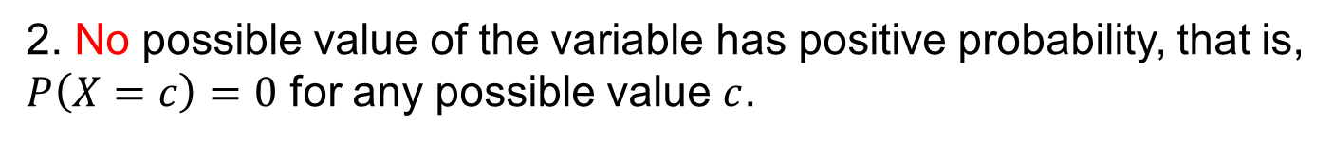
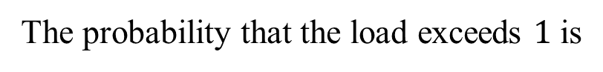
The probability that the load is between $1$and $1.5$is
$P\left(1≤X≤1.5\right)=F\left(1.5\right)−F\left(1\right)=\frac{3}{16}+\frac{3}{16}\left(\frac{9}{4}\right)−\frac{1}{8}−\frac{3}{16}=\frac{19}{64}$.
The probability that the load exceeds $1$ is
$P\left(X>1\right)=1−P\left(X≤1\right)=1−F\left(1\right)=1−\frac{1}{8}−\frac{3}{16}=\frac{11}{16}.$
Once the cdf has been obtained, any probability involving $X$ can easily be calculated without any further integration.

Slide 16
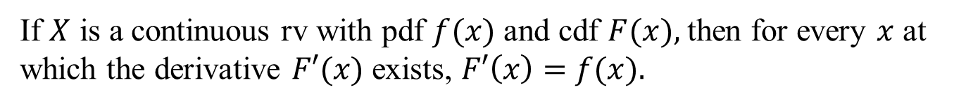
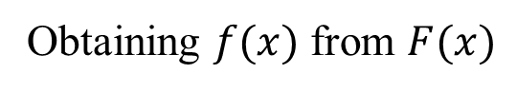
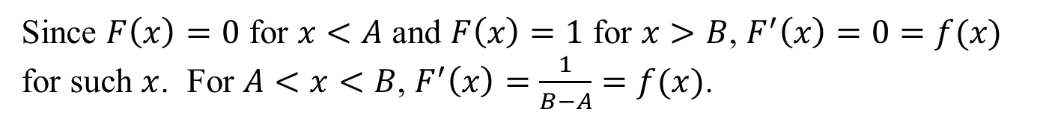
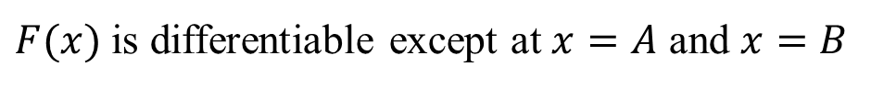
Proposition
Obtaining $f(x)$from $F(x)$
If $X$ is a continuous rv with pdf $f(x)$and cdf $F(x),$then for every $x$ at which the derivative $F′(x)$exists, $F′\left(x\right)=$ $f(x).$
Example When $X$ has a uniform distribution, the cdf $F(x)$ is as follows
$F\left(x\right)=\left\{\begin{aligned} 0 x≤A \\ \frac{x−A}{B−A} Α<x≤B \\ 1 x>B \end{aligned}\right.$
$$1$$
$$A$$
$$B$$
$F(x)$is differentiable except at $x=A$ and $x=B$
Since $F\left(x\right)=0$ for $x<A$ and $F\left(x\right)=1$ for $x>B$, $F^{′}\left(x\right)=0=f(x)$ for such $x$. For $A<x<B$, $F^{′}\left(x\right)=\frac{1}{B−A}=f(x)$.

Slide 17
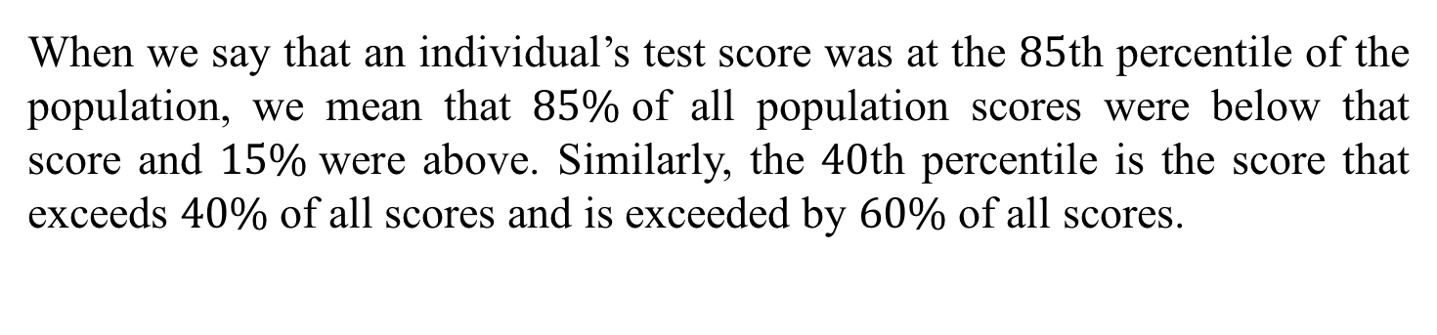
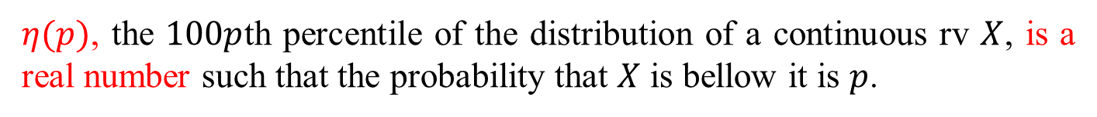
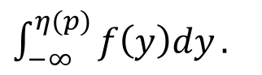
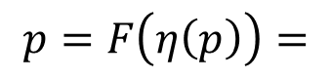
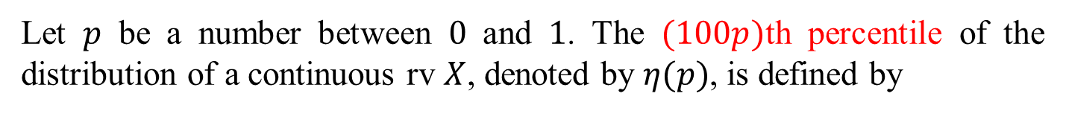
Percentiles of a Continuous Distribution
When we say that an individual’s test score was at the $85$th percentile of the population, we mean that $85\%$of all population scores were below that score and $15\%$were above. Similarly, the $40$th percentile is the score that exceeds $40\%$of all scores and is exceeded by $60\%$of all scores.
Definition
Let $p$ be a number between $0$ and $1$. The $(100p)$th percentile of the distribution of a continuous rv $X$, denoted by $η(p)$, is defined by
$$p=F\left(η\left(p\right)\right)=$$
$\int_{−∞}^{η(p)}{f\left(y\right)dy}.$
$η(p)$, the $100p$th percentile of the distribution of a continuous rv $X$, is a real number such that the probability that $X$ is bellow it is $p$.

Slide 18


In general, we have two ways to find out $η(p)$.
If cdf is available, then we solve the equation $F\left(η\left(p\right)\right)=p$.
If only the pdf is available, then we solve$\int_{−∞}^{η(p)}{f\left(y\right)dy}=p$.
If we repeatedly perform the same experiments, then in the long run a ratio of $p$ among all the observed values will be less than $η\left(p\right)$and a ratio $1−p$ will be more than $η(p)$.

Slide 19







Example
The distribution of the amount of gravel (in tons) sold by a particular construction supply company in a given week is a continuous rv $X$ with pdf
$f\left(x\right)=\left\{\begin{aligned}\frac{3}{2}\left(1−x^{2}\right) 0≤x≤1 \\ 0 otherwise \end{aligned}\right.$
And the cdf is
$$F\left(x\right)=\left\{\begin{aligned} 0 x<0 \\ \\ \\ 1 x>1\end{aligned}\right.$$
$\frac{3}{2}x−\frac{1}{2}x^{3}$
$$0≤x≤1$$
What is the $50$th percentile?
Or $η(0.5)$?

Slide 20






We have two ways to find out $η(0.5)$.
1. Since cdf is available, we can solve the following equation
$F\left(η\left(0.5\right)\right)=0.5$.
Since $F\left(x\right)≠0.5$ for $x<0$ or $x>1$, $0<η\left(0.5\right)<1$. We substitute $x=η(0.5)$ into the cdf to find that
$$\frac{3}{2}η\left(0.5\right)−\frac{1}{2}η{\left(0.5\right)}^{3}=0.5,$$
which implies $η(0.5)$ is the solution of the following equation
$x^{3}−3x+1=0$.
The equation has three solutions, only one is between$0$ and 1, which is $0.347$. And thus $η\left(0.5\right)=0.345$.

Slide 21



2. If only pdf is available, there is no need to derive the cdf. Instead we can solve the following equation
$$\int_{−∞}^{η(0.5)}{f\left(y\right)dy}=0.5 .$$
In this case
$\int_{0}^{η(0.5)}{\frac{3}{2}\left(1−x^{2}\right)dx}=0.5$.
$0<η\left(0.5\right)<1$ and
That is $\frac{3}{2}η\left(0.5\right)−\frac{1}{2}η{\left(0.5\right)}^{3}=0.5.$
Solving the equation we can obtain $η\left(0.5\right)=0.345$.

Slide 22



Definition
The median of a continuous distribution, denoted by $\tilde{μ}$ , is the $50$^{th} percentile, so $\tilde{μ}$ satisfies $F\left(\tilde{μ}\right)=0.5$.
A continuous distribution whose pdf is symmetric has median $\tilde{μ}$equal to the point of symmetry
Examples:

Slide 23



Expected Values
For a discrete random variable $X$, $E(X)$is the weighted average of all possible values.
For a continuous random variable $X$, we replace summation by integration and the pmf by the pdf to get the weighted average.
The expected or mean value of a continuous rv $X$ with pdf $f(x)$is
$μ_{X}=E\left(X\right)=\int_{−∞}^{+∞ }{x ⋅f(x)}dx$.

Slide 24




Example
The pdf of weekly gravel sales $X$ was
$f\left(x\right)=\left\{\begin{aligned}\frac{3}{2}\left(1−x^{2}\right) 0≤x≤1 \\ 0 otherwise \end{aligned}\right.$
What is $E(X)$?
$E\left(X\right)=\int_{0}^{1}{x∙\frac{3}{2}\left(1−x^{2}\right)dx}=\frac{3}{4}−\frac{3}{8}=\frac{3}{8}$

Slide 25



The Expected Value of a Function
If $X$ is a continuous rv with pdf $f(x)$and $h(X)$is any function of $X$, then
$μ_{h(X)}=E\left(h(X)\right)=\int_{−∞}^{+∞ }{h(x) ⋅f(x)}dx$.
That is, $E(h(X))$is computed in the same way that $E(X)$itself is, except that $h(x)$is substituted in place of $x$.
Let $Y=h(X)$. $Y$ is also an rv. However we find that it was not necessary to determine the distribution of $Y$ in order to obtain $E\left(Y\right)!$

Slide 26


Example The pdf of weekly gravel sales $X$ was
$f\left(x\right)=\left\{\begin{aligned}\frac{3}{2}\left(1−x^{2}\right) 0≤x≤1 \\ 0 otherwise \end{aligned}\right.$
Let $h\left(X\right)=\left\{\begin{aligned}1 X≤0.5 \\ 0 X>0.5\end{aligned}\right.$. What is $E(h(X))$?
$$E\left(h(X)\right)=\int_{0}^{1}{h(x)∙f\left(x\right)dx}$$
Solution
$=\int_{0}^{0.5}{\frac{3}{2}\left(1−x^{2}\right)dx}$
$=\frac{3}{2}\left(\frac{1}{2}−\frac{1}{24}\right)=\frac{33}{48}=\frac{11}{16}$

Slide 27




In this example, $Y=h(X)$ is a Bernoulli rv. What is pmf of $Y$?
$$P\left(Y=1\right)=P\left(X≤0.5\right)$$
$=\int_{0}^{0.5}{\frac{3}{2}\left(1−x^{2}\right)dx}=\frac{11}{16}$ .
$$P\left(Y=0\right)=P(X>0.5)$$
$=1−P\left(X≤0.5\right)=1−\frac{11}{16}=\frac{5}{16}$.
$E\left(Y\right)=1\left(\frac{11}{16}\right)+0\left(\frac{5}{16}\right)=\frac{11}{16}$.
Clearly, in order to obtain $E\left(h(X)\right)$, the former method is better.

Slide 28



Example
Let $X$ be a uniform rv with pdf
$f\left(x\right)=\left\{\begin{aligned}1 0≤x≤1 \\ 0 otherwise \end{aligned}\right.$.
L$et g\left(X\right)=\max\left\{X,1−X\right\}=\left\{\begin{aligned}1−X 0≤X<0.5 \\ X 0.5≤X≤1\end{aligned}\right.$ , what is $E(g(X))$?
$$E\left(g(X)\right)=\int_{0}^{1}{g(x)∙f\left(x\right)dx}$$
$=\int_{0}^{0.5}{(1−x)dx}+\int_{0.5}^{1}{x∙dx}$
$=\frac{3}{8}+\frac{3}{8}=\frac{3}{4}$

Slide 29







In this example, the set of possible values of $Y=g(X)$ is $[0.5, 1]$ and thus $Y$ a continuous rv. Can you find pdf of $Y$?
To find out the pdf of $Y$, we need to compute the cdf first.
For any $y∈(0.5,1)$
$$F\left(y\right)=P\left(Y≤y\right)=P(g(X)≤y)$$
$$=P(max⁡(X,1−X)≤y)$$
$$=P(X≤y and 1−X≤y)$$
$$=\int_{1−y}^{y}{1dx}=2y−1$$
$$=P(1−y≤X≤y)$$
So for any $y∈(0.5,1)$, the pdf $f\left(y\right)=F^{′}\left(y\right)=2$ and for other values of $y$, $f(y)=0$.
$E\left(Y\right)=\int_{0.5}^{1}{y∙2dy}=\frac{3}{4}$.

Slide 30

Rules of Expected Value
If $h(X)$is a linear function $aX+b$, then $E[h(X)]$can be easily computed from $E(X)$.
Proposition
$E\left(aX+b\right)=aE\left(X\right)+b$, where both $a$ and $b$ are constants.
This proposition holds for both discrete rv and continuous rv.

Slide 31





The Variance of $X$
The variance of$X$, denoted by $V(X)$ or $σ_{X}^{2}$ or just $σ^{2}$, is
$V\left(X\right)=E({(X−μ)}^{2})$.
And thus if the pdf of a continuous rv is $f(x)$, then
$V(X)=\int_{−∞}^{+∞ }{{\left(x−μ\right)}^{2} ⋅f(x)}dx$.
The shortcut formula employed in the discrete case still holds for the continuous case.
$V\left(X\right)=E\left(X^{2}\right)−E{\left(X\right)}^{2}$.
What is $V\left(aX+b\right)$? where both $a$ and $b$ are constants.
$V\left(aX+b\right)=a^{2}V\left(X\right)$.

Slide 32

Example: the expected value and variance of uniform distribution
Let $X$ be a uniform rv with pdf
$f\left(x\right)=\left\{\begin{aligned}\frac{1}{B−A} A≤x≤B \\ 0 otherwise \end{aligned}\right.$.
$E\left(X\right)=\int_{A}^{B}{\frac{x}{B−A}dx}=\frac{1}{2}(B+A)$
$E\left(X^{2}\right)=\int_{A}^{B}{\frac{x^{2}}{B−A}dx}=\frac{1}{3}(A^{2}+AB+B^{2})$
$V\left(X\right)=E\left(X^{2}\right)−E{\left(X\right)}^{2}=\frac{1}{3}(A^{2}+AB+B^{2})−\frac{1}{4}{\left(A+B\right)}^{2}=\frac{1}{12}{\left(B−A\right)}^{2}$

Slide 33








If the pdf is symmetric, both the median $\tilde{μ}$and the expected value $μ$ equal to the point of symmetry.
Case 1. If the pdf of $X$ is symmetric about $0$, then
$$E\left(X\right)=\int_{−∞}^{∞}{x∙f(x)}dx$$
$$=0$$
$G\left(x\right)=x∙f(x)$ is an odd function
Case 2. Suppose the pdf of $X$ is symmetric about $μ$, that is $f\left(μ+x\right)=f(μ−x)$ for all$x$.
Let $Y=X−μ$. What is the pdf of $Y$?
The pdf of $Y$ is $g\left(y\right)=f(y+μ)$.
Since $g\left(−y\right)=f\left(−y+μ\right)=f\left(y+μ\right)=g(y)$, $g\left(y\right)$ is symmetric about $0$.
From case 1. $E\left(Y\right)=0.$
And Thus $E\left(X\right)=E\left(Y+μ\right)=μ.$

Slide 34
4.3 The Normal Distribution
The normal distribution
The normal distribution, also called Gauss distribution, is the most important one in all of probability and statistics.
Many numerical populations have normal distributions. Common examples include heights, weights, and other physical Characteristics, scores on various tests and so on.
In addition, even when individual variables themselves are not normally distributed, sums and averages of the variables will under suitable conditions have approximately a normal distribution; this is the content of the Central Limit Theorem discussed in the next chapter.

Slide 35



Definition
A continuous rv$X$is said to have a normal distribution with parameters $μ$ and $σ$, where $−∞<μ<∞$ and $σ>0$, if the pdf of $X$ is
$f\left(x;μ,σ\right)=\frac{1}{\sqrt{2π}σ}e^{−{\left(x−μ\right)}^{2}/(2σ^{2})}$ $−∞<x<∞$
Again $e$ denotes the base of the natural logarithm system and equals approximately $2.71828$,
We will often write $X\sim N(μ,σ^{2})$ to indicate that $X$ is normally distributed with parameters $μ$ and $σ$.

Slide 36




The following figure presents graphs of $f\left(x;μ,σ\right)$ for two different $(μ, σ)$ pairs.
Each density curve is symmetric about $μ$.
So the point of symmetry $μ$ is both the mean and the median of the distribution.
Large values of $σ$yield graphs that are quite spread out about $μ$. Later we will find that $σ$ is indeed the standard deviation of the distribution.

Slide 37



The standard normal distribution ($μ=0$ and $σ=1$)
A random variable having a standard normal distribution is called a standard normal random variable and will be denoted
by $Z$. The pdf of $Z$ is
$f\left(z;0,1\right)=\frac{1}{\sqrt{2π}}e^{−z^{2}/2}$ $−∞<z<∞$
It can be shown by calculus argument that
$\int_{−∞}^{∞}{\frac{1}{\sqrt{2π}}e^{−z^{2}/2}dz}=1$.
So $f\left(z;0,1\right)$ is a legitimate density function.

Slide 38

The expected value and variance of standard normal distribution
$f\left(z;0,1\right)$ is symmetric about $0$ and thus $E\left(Z\right)=0$. On the other hand
$E\left(Z^{2}\right)=\int_{−∞}^{∞}{z^{2}∙\frac{1}{\sqrt{2π}}e^{−z^{2}/2}dz}=\frac{−1}{\sqrt{2π}}\int_{−∞}^{∞}{zde^{−z^{2}/2}}$
$=\frac{1}{\sqrt{2π}}\int_{−∞}^{∞}{e^{−z^{2}/2}dz}=1$
$V\left(Z\right)=E\left(Z^{2}\right)−E{\left(Z\right)}^{2}=1$.

Slide 39

The cdf of standard normal distribution
The cdf of $Z$ is $P\left(Z≤z\right)=\int_{−∞}^{z}{\frac{1}{\sqrt{2π}}e^{−z^{2}/2}dz}$, which we denote by $Φ(z)$.

Slide 40



Slide 41






Example Let’s determine the following standard normal probabilities: (a) $P(Z≤0.95)$; (b) $P(Z≤−2.95)$; (c) $P\left(−0.95≤Z≤0.95\right).$
Solution
(a) $P\left(Z≤0.95\right)=Φ\left(0.95\right)=0.8289$;
(b) $P\left(Z≤−2.95\right)=Φ\left(−2.95\right)=0.0016$
(c) Since $f\left(z;0,1\right)$ is symmetric about $0$,
$\int_{−∞}^{−a}{\frac{1}{\sqrt{2π}}e^{−z^{2}/2}}dz$
$=\int_{a}^{∞}{\frac{1}{\sqrt{2π}}e^{−y^{2}/2}dy}$.
It means that $Φ\left(−a\right)=1−Φ(a)$ for any $a$.
$$P\left(−0.95≤Z≤0.95\right)=Φ\left(0.95\right)−Φ\left(−0.95\right)=2Φ\left(0.95\right)−1$$
$=0.6578$.
More general, $P\left(−a≤Z≤a\right)=2Φ\left(a\right)−1$ for any $a$.

Slide 42


Percentiles of the Standard Normal Distribution
For any $p$ between $0$ and $1$, Appendix Table A.3 can be used to obtain the ($100p$)th percentile of the standard normal distribution.
What is $85$th percentile of the standard normal distribution?
If$p$does not appear in the table, the number closest to it is often used.
Because $P\left(Z≤1.04\right)=Φ\left(1.04\right)=0.8508$.
The $85$th percentile is approximately $1.04$.

Slide 43



$z_{α}$ Notation for $z$ Critical Values (临界值)
$z_{α}$will denote the real number such that
$Φ\left(z_{α}\right)=1−α$, or equivalently $P\left(Z≥z_{α}\right)=α$.

Slide 44




Critical Values and Percentiles of the Standard Normal Distribution
Since ${Φ(z}_{α})=1−α$, $z_{α}$ is $100(1−α)$th Percentiles.
$$Φ\left(1.28\right)=0.9$$
$z_{0.05}=1.645$.
What is $z_{0.05}$?
What is $P(|Z|≥1.645)$?
$$P\left(\left|Z\right|≥1.645\right)=P\left(Z≥1.645\right)+P\left(Z≤−1.645\right)=0.1$$
Symmetric!

Slide 45
Nonstandard and standard Normal Distributions
Suppose $X\sim N(μ,σ^{2})$. Let $Z=\frac{X−μ}{σ}$. Then for any real number $z$
$$P\left(Z≤z\right)=P\left(X≤σz+μ\right)$$
$=\int_{−∞}^{σz+μ}{\frac{1}{\sqrt{2π}σ}e^{−{\left(x−μ\right)}^{2}/(2σ^{2})} dx}$
$$=\int_{−∞ }^{z}{\frac{1}{\sqrt{2π}}e^{−y^{2}/2}dy}$$
( $y=\frac{x−μ}{σ}$ )
And thus$Z\sim N(0,1)$.
Since $E\left(Z\right)=0$ and $V\left(Z\right)=1$, $E\left(X\right)=E\left(σZ+μ\right)=μ,$
$V\left(X\right)=V\left(σZ+μ\right)=σ^{2}V\left(Z\right)=σ^{2}$.

Slide 46



Proposition
If $X\sim N\left(μ,σ^{2}\right),$ then $Z=\frac{X−μ}{σ}$ $\sim N(0,1)$.
$P\left(a≤X≤b\right)=P\left(\frac{a−μ}{σ}≤Z≤\frac{b−μ}{σ}\right)$.
$=Φ\left(\frac{b−μ}{σ}\right)−Φ\left(\frac{a−μ}{σ}\right)$
$P\left(X≤b\right)=P(Z≤\frac{b−μ}{σ})$
$=Φ\left(\frac{b−μ}{σ}\right)$
$P\left(X≥a\right)=P(Z≥\frac{a−μ}{σ})$
$=1−Φ\left(\frac{a−μ}{σ}\right)$

Slide 47

Example
Suppose a random variable $X$ has a normal distribution having mean value $1.25$ and standard deviation of$0.46$. What is the probability that $1≤X≤1.75$.
$P\left(1≤X≤1.75\right)=P\left(\frac{1−1.25}{0.46}≤Z≤\frac{1.75−1.25}{0.46}\right)\text{.}$
$=Φ\left(\frac{1.75−1.25}{0.46}\right)−Φ\left(\frac{1−1.25}{0.46}\right)$
$$=Φ\left(1.09\right)−Φ\left(−0.54\right)$$
$$=0.8621−0.2946=0.5675$$

Slide 48
Example
If $X\sim N\left(μ,σ^{2}\right)$, then
$P\left(μ−σ≤X≤μ+σ\right)=P\left(\frac{μ−σ−μ}{σ}≤Z≤\frac{μ+σ−μ}{σ}\right)$
$$=P(−1≤Z≤1)$$
$=Φ\left(1\right)−Φ\left(−1\right)=\text{0.6828}$
$P\left(μ−2σ≤X≤μ+2σ\right)=P\left(\frac{μ−2σ−μ}{σ}≤Z≤\frac{μ+2σ−μ}{σ}\right)$
$$=P\left(−2≤Z≤2\right)=0.9544$$
$P\left(μ−3σ≤X≤μ+3σ\right)=P\left(\frac{μ−3σ−μ}{σ}≤Z≤\frac{μ+3σ−μ}{σ}\right)$
$$=P\left(−3≤Z≤3\right)=0.9974$$

Slide 49
Conclusion
If the population distribution of a variable is (approximately) normal, then
1. Roughly $68\%$of the values are within $1$SD of the mean.
2. Roughly $95\%$of the values are within $2$ SDs of the mean.
3. Roughly $99.7\%$of the values are within $3$ SDs of the mean.
It is indeed unusual to observe a value from a normal population that is much farther than $2$ standard deviations from.

Slide 50



The Normal Distribution and Discrete Populations
The normal distribution is often used as an approximation to the distribution of a discrete rv.
Approximating the Binomial Distribution
Let $X\sim Bin(n,p)$ having pmf
$$b\left(x;n,p\right)=\left\{\begin{aligned}\left({n \atop x}\right)p^{x}{\left(1−p\right)}^{n−x}, x=0,1,2,…,n \\ 0, otherwise\end{aligned}.\right.$$
In Chapter 3, we show that when $n$ is large and $p$ is small, $b(x;n,p)≈p(x;μ)$ , where $p(x;μ)$ is the pmf of a Poisson rv and $μ=np$.
As a rule, this approximation can safely be applied if $n>50$ and $np<5$.

Slide 51



Let $X\sim Bin(20,0.6)$. The following figure gives the probability histogram of $X$.
We find that a normal curve with $μ=12$ and $σ=2.19$ gives a very good approximation, especially in the middle part of the picture.
Here $μ=E\left(X\right)=np$ and $σ=\sqrt{V(X)}=\sqrt{npq}$.

Slide 52


If we let $Y\sim N(12,2.19)$, then
$P\left(X=12\right)=b(12;20,0.6)$
$$=b(12;20,0.6)∙(12.5−11.5)$$
$$≈\int_{11.5}^{12.5}{f\left(x;12,2.19\right)dx}$$
$=P(11.5≤Y≤12.5)$.
$=Φ\left(\frac{12.5−12}{2.19}\right)−Φ\left(\frac{11.5−12}{2.19}\right)$
In fact the area of any rectangle (probability of any particular $X$ value) except those in the extreme tails can be accurately approximated by the corresponding normal curve area.

Slide 53


Proposition
Let $X$ be a binomial rv based on $n$ trials with success probability $p$. Then if the binomial probability histogram is not too skewed, $X$ has approximately a normal distribution with $μ=np$ and $σ=\sqrt{npq}$. In particular, for $x=$a possible value of $X$,
$$P\left(X≤x\right)=B(x;n,p)≈\left({\text{area} \text{under} \text{the} \text{normal} \text{curve} \atop to the left of x+0.5}\right)$$
$$=Φ\left(\frac{x+0.5−np}{\sqrt{npq}}\right)$$
In practice, the approximation is adequate provided that both $np≥10$ and $nq≥10$, since there is then enough symmetry in the underlying binomial distribution.

Slide 54
$X\sim Bin(4, 0.5)$.
$X\sim N(2,1)$.

Slide 55


$X\sim Bin(5, 0.1)$.
$X\sim Bin(10, 0.1)$.
$X\sim Bin(50, 0.1)$.

Slide 56



Example Suppose that $25\%$of all students at a large public university receive financial aid. Let $X$ be the number of students in a random sample of size$50$who receive financial aid. Since $np=12.5≥10$ and $nq=37.5≥10$, the approximation can safely be applied. Then $μ=12.5$ and $σ=3.06$. The probability that at most $10$ students receive aid is
$$Φ\left(\frac{10+0.5−12.5}{3.06}\right)$$
$$P\left(X≤10\right)=B(10;n,p)≈$$
$$=Φ\left(−0.65\right)=0.2578$$
Similarly
$$P\left(5≤X≤15\right)=B\left(15;50,0.25\right)−B(4;50,0.25)$$
$$≈Φ\left(\frac{15+0.5−12.5}{3.06}\right)−Φ\left(\frac{4+0.5−12.5}{3.06}\right)=0.832.$$

Slide 57
4.4 The Exponential and Gamma Distributions
The Exponential Distribution
$X$ is said to have an exponential distribution with parameter $λ (λ>0)$ if the pdf of $X$ is
$f\left(x;λ\right)=\left\{\begin{aligned}λe^{−λx} x≥0 \\ 0 otherwise\end{aligned}\right.$.
Observe that
$\int_{−∞}^{∞}{f\left(x;λ\right)dx}=\int_{0}^{∞}{λe^{−λx}dx}=−\left(e^{−∞}−e^{0}\right)=1$.
So $f\left(x;λ\right)$ is a legitimate density function.

Slide 58
The expected value and variance of the exponential distribution
$E\left(X\right)=\int_{−∞}^{∞}{x∙f\left(x;λ\right)dx}=\int_{0}^{∞}{x∙λe^{−λx}dx}$
$=−\int_{0}^{∞}{x∙de^{−λx}}$
$=−\left(x∙e^{−λx}\left|\begin{matrix}x=∞ \\ x=0\end{matrix}\right.−\int_{0}^{∞}{e^{−λx}dx}\right)$
$=\frac{1}{λ }\int_{0}^{∞}{λe^{−λx}dx}=\frac{1}{λ}$ .

Slide 59

$E(X^{2}) =\int_{−∞}^{∞}{x^{2}∙f\left(x;λ\right)dx}=\int_{0}^{∞}{x^{2}∙λe^{−λx}dx}$
$=−\int_{0}^{∞}{x^{2}∙de^{−λx}}$
$=−\left(x^{2}∙e^{−λx}\left|\begin{matrix}x=∞ \\ x=0\end{matrix}\right.−2\int_{0}^{∞}{x∙e^{−λx}dx}\right)$
$=\frac{2}{λ}\int_{0}^{∞}{x∙λe^{−λx}dx}$
$=\frac{2}{λ^{2}}$
$V\left(X\right)=E\left(X^{2}\right)−E{\left(X\right)}^{2}=\frac{1}{λ^{2}}$
Both the mean and standard deviation of the exponential distribution equal $\frac{1}{λ}$ .

Slide 60



The cdf of the exponential distribution.
For any $x>0$
$F\left(x;λ\right)=\int_{−∞}^{x}{f\left(y;λ\right)dy}=\int_{0}^{x}{λe^{−λy}dy}$
$$=−e^{−λx}+1$$
And thus $F\left(x;λ\right)=\left\{\begin{matrix}0 & x≤0 \\ 1−e^{−λx} & x>0\end{matrix}\right.$

Slide 61
Example Suppose the distribution of stress range in certain bridge connections is the exponential distribution with mean value 6 Mpa.
What’s the probability that stress range is at most $10$ Mpa?
Solution: $E\left(X\right)=\frac{1}{λ}=6$ implies that $λ=\frac{1}{6}=0.1667.$
$P\left(X≤10\right)=F\left(10;0.1667\right)=1−e^{−1.667}=1−0.189=0.811$.

Slide 62


The application of the Exponential Distribution
The exponential distribution is frequently used as a model for the distribution of times between the occurrence of successive events.
Proposition related to the Poisson process
Suppose that the number of events occurring in any time interval of length $t$has a Poisson distribution with parameter $αt$ (where $α$ is the expected number of events occurring in $1$ unit of time) and that numbers of occurrences in non-overlapping intervals are independent of one another.
Then the distribution of time between the occurrence of two successive events is exponential with parameter $α$.

Slide 63
In fact, the times between two successive events, known as interarrival (两次间隔) times, are independent, identically distributed random variables.
Let $X_{1}$ be the time until the first event occurs. For any $t>0$
$$P\left(X_{1}≤t\right)=$$
$$P(at least one event occurs in (0,t))$$
$$=1−P(no event in (0,t))$$
$$=1−\frac{e^{−αt}{\left(αt\right)}^{0}}{0!}$$
$$=1−e^{−αt}$$
which is exactly the cdf of the exponential distribution.

Slide 64


Example
Suppose that calls are received at a $24$-hour “suicide hotline” according to a Poisson process with rate $α=0.5$ call per day. What is the probability that the time gap between two successive calls is more than $2$ days?
Solution: Then the number of days $X$ between successive calls has an exponential distribution with parameter value $0.5$,
$$P\left(X>2\right)=1−P\left(X≤2\right)=1−\left(1−e^{−0.5×2}\right)=\frac{1}{e}=.368$$
The expected time between successive calls is $\frac{1}{0.5}=2$.

Slide 65

Another important application of the exponential distribution is to model the distribution of component lifetime.
Example Suppose that the lifetime $X$ of a fuse (in $100$hour units) has an exponential distribution with $P(X >10) = 0.8$. Find the mean and standard deviation of $X$.
$$P\left(X>10\right)=1−F\left(10;λ\right)=1−\left(1−e^{−10λ}\right)=e^{−10λ}=0.8$$
$λ=−\frac{\ln\left(0.8\right)}{10}=0.0223$.
$E\left(X\right)=\frac{1}{λ}=44.843 (100 hours)$.
$$σ_{X}=44.843(100 hours)\text{.}$$

Slide 66

The “memoryless” property of the exponential distribution.
If the first arrival has not occurred by time $t_{0}$, then the time remaining until the arrival occurs has the same distribution as the first arrival time itself. In mathematics
$P\left(X≥t+t_{0} | X≥t_{0}\right)=P(X≥t)$.
Proof.
$P\left(X≥t+t_{0} | X≥t_{0}\right)=\frac{P\left[\left(X≥t+t_{0}\right)∩\left(X≥t_{0}\right)\right]}{P(X≥t_{0})}$
$=\frac{P(X≥t+t_{0})}{P(X≥t_{0})}$
$=\frac{1−F(t+t_{0};λ)}{1−F(t_{0};λ)}$
$$=\frac{e^{−λ(t+t_{0})}}{e^{−λt_{0}}}=e^{−λt}$$
$$=P(X≥t)$$

Slide 67
For many component, the distribution of remaining lifetime is approximately independent of current age.
However some other components deteriorate with age or occasionally improve with age (at least up to a certain point).
And thus we need more general lifetime models such as gamma distributions (Refer to the textbook).

Slide 68

2) Gamma distribution
Definition
For $α>0$, the gamma function $Γ\left(α\right)$ is defined by
$$Γ\left(α\right)=\int_{0}^{∞}{x^{α−1}e^{−x}dx}$$
The most important properties of the gamma function are the following:
1. For any $α>1$, $Γ\left(α\right)=(α−1)∙Γ\left(α−1\right)$[via integration by parts]
2. For any positive integer $n$, $Γ\left(n\right)=\left(n−1\right)!$
3. $Γ\left(\frac{1}{2}\right)=\sqrt{π}$

Slide 69


Slide 70

Definition
A continuous random variable $X$ is said to have a gamma distribution if the pdf of $X$ is
$$f\left(x;α,β\right)=\left\{\begin{aligned}\frac{1}{β^{α}Γ(α)}x^{α−1}e^{−x/β} x≥0 \\ 0 otherwise\end{aligned}\right.$$
where the parameters $α$ and $β$ satisfy $α>0,β>0$. The standard gamma distribution has $β=1$.
The exponential distribution results from taking $α=1,β=1/λ$.

Slide 71



Slide 72


Proposition
The mean and variance of a random variable $X$ having the gamma distribution $f(x;α,β)$ are
$$E\left(X\right)=μ=αβ V\left(X\right)=σ^{2}=αβ^{2}$$
Proof:
$E\left(X\right)=\int_{0}^{∞}{\frac{1}{β^{α}Γ(α)}x^{α}e^{−x/β}dx}=\frac{1}{β^{α}Γ(α)}\int_{0}^{∞}{x^{α}e^{−x/β}dx}$
$=\frac{β}{Γ(α)}\int_{0}^{∞}{{(\frac{x}{β})}^{α}e^{−\frac{x}{β}}d(\frac{x}{β})}=\frac{Γ(α+1)}{Γ(α)}β=αβ$
$E\left(X^{2}\right)=\int_{0}^{∞}{\frac{1}{β^{α}Γ(α)}x^{α+1}e^{−x/β}dx}=\frac{1}{β^{α}Γ(α)}\int_{0}^{∞}{x^{α+1}e^{−x/β}dx}$
$=\frac{β^{2}}{Γ(α)}\int_{0}^{∞}{{(\frac{x}{β})}^{α+1}e^{−\frac{x}{β}}d(\frac{x}{β})}=\frac{Γ(α+2)}{Γ(α)}β^{2}=α\left(α+1\right)β^{2}$
$$V\left(X\right)=E\left(X^{2}\right)−{\left[E\left(X\right)\right]}^{2}=α\left(α+1\right)β^{2}−α^{2}β^{2}=αβ^{2}$$

Slide 73

Example3: Suppose the reaction time X of a randomly selected individual to a certain stimulus has a standard gamma distribution with $α=2$ sec. Since
$$P\left(a≤X≤b\right)=F\left(b\right)−F(a)$$
when X is continuous,
$$P\left(3≤X≤5\right)=F\left(5;2\right)−F\left(3;2\right)=.960−.801=.159$$
The probability that the reaction time is more than 4 sec is
$$P\left(X>4\right)=1−P\left(X≤4\right)=1−F\left(4;2\right)=1−.908=.092$$

Slide 74

Definition
When $X$ is a standard gamma rv, the cdf of $X$,
$$F\left(x;α\right)=\int_{0}^{x}{\frac{y^{α−1}e^{−y}}{Γ\left(α\right)}dy} x>0$$
is called the incomplete gamma function.

Slide 75


Proposition
Let $X$ have a gamma distribution with parameters $α$ and $β$ . Then for any $x>0$, the cdf of $X$ is given by
$$P\left(X≤x\right)=F\left(x;α,β\right)=F(\frac{x}{β};α)$$
where $F( ∙ ;α)$ is the incomplete gamma function.
Proof:
$$F\left(x;α,β\right)=\int_{0}^{x}{\frac{1}{β^{α}Γ(α)}y^{α−1}e^{−y/β}dy}=\int_{0}^{x}{\frac{1}{Γ\left(α\right)}{(\frac{y}{β})}^{α−1}e^{−\frac{y}{β}}d(\frac{y}{β})}$$
$$=\int_{0}^{\frac{x}{β}}{\frac{z^{α−1}e^{−z}}{Γ\left(α\right)}dz}=F\left(\frac{x}{β};α\right)$$

Slide 76

Example4: Suppose the survival time $X$ in weeks of a randomly selected male mouse exposed to 240 rads of gamma radiation has a gamma distribution with $α=8$ and $β=15$. The expected survival time is $E\left(X\right)=\left(8\right)\left(15\right)=120$ weeks, whereas $V\left(X\right)=\left(8\right){\left(15\right)}^{2}=1800$and $σ_{X}=\sqrt{1800}=42.43$ weeks. The probability that a mouse survives between 60 and 120 weeks is
$$P\left(60≤X≤120\right)=P\left(X<+120\right)−P(X≤60)$$
$$=F\left(120/15;8\right)−F\left(60/15;8\right)$$
$$=F\left(8;8\right)−F\left(4;8\right)=.547−.051=.496$$
The probability that a mouse survives at least 30 weeks is
$$P\left(X≥30\right)=1−P\left(X<30\right)=1−P\left(X≤30\right)$$
$$=1−F\left(30/15;8\right)=.999$$

Slide 77

The Chi-Squared Distribution ( a special Gamma)
If $X1,X2,…,X_{m}$ are $m$ independent random variables having the standard normal distribution, then $Y=X_{1}^{2}+X_{2}^{2}+…+X_{m}^{2}$ has a Chi-Squared distribution with $m$ degrees of freedom.
What are $E\left(Y\right)$ and $V\left(Y\right)$?
Solution:
$$E\left(Y\right)=mE\left(X_{1}^{2}\right)=m$$
$$E\left(X_{1}^{4}\right)=\int_{−∞}^{∞}{z^{4}∙\frac{1}{\sqrt{2π}}e^{−z^{2}/2}dz}=\frac{−1}{\sqrt{2π}}\int_{−∞}^{∞}{z^{3}de^{−z^{2}/2}}$$
$=\frac{3}{\sqrt{2π}}\int_{−∞}^{∞}{z^{2}e^{−z^{2}/2}dz}$
$$=3E\left(X_{1}^{2}\right)=3$$
$$V\left(X_{1}^{2}\right)=E\left(X_{1}^{4}\right)−E{\left(X_{1}^{2}\right)}^{2}=3−1=2$$
$$V\left(Y\right)=mV\left(X_{1}^{2}\right)=2m$$

Slide 78


Proposition
If $X∼N(0,1)$, then ${Y=X}^{2}∼χ^{2}\left(1\right).$
Proof: In virtue of the the definition cdf, we have
$$P\left({Y=X}^{2}≤y\right)=\left\{\begin{aligned}P\left(−\sqrt{y}≤X≤\sqrt{y}\right), y>0 \\ 0 , y≤0\end{aligned}\right.$$
Then $P\left(−\sqrt{y}≤X≤\sqrt{y}\right)=\int_{−\sqrt{y}}^{\sqrt{y}}{\frac{1}{\sqrt{2π}}exp\left(−\frac{x^{2}}{2}\right)dx}$
$$=\frac{2}{\sqrt{2π}}\int_{0}^{y}{\frac{e^{−\frac{x}{2}}}{2\sqrt{x}}dx}$$
$$=\int_{0}^{y}{\frac{e^{−\frac{x}{2}}x^{\frac{1}{2} −1}}{2^{\frac{1}{2}}Γ(\frac{1}{2}) }dx=}\int_{0}^{y}{f\left(x;1\right)dx.}$$
which completes the proof.

Slide 79

4.5 Other Continuous Distributions
1) Weibull distribution
Definition
A random variable $X$ is said to have a Weibull distribution with parameters $α$ and $β(α>0,β>0)$ if the pdf of $X$ is
$$f\left(x;α,β\right)=\left\{\begin{aligned}\frac{α}{β^{α}}x^{α−1}e^{−{(x/β)}^{α}} x≥0 \\ 0 x<0\end{aligned}\right.$$
The cdf of a Weibull rv having parameters $α$ and $β$ is
$$F\left(x;α,β\right)=\left\{\begin{aligned} 0 x<0 \\ 1−e^{−{\left(\frac{x}{β}\right)}^{α}} x≥0\end{aligned}\right.$$

Slide 80


Remark 1:
$$μ=\int_{0}^{+∞}{α{\left(\frac{x}{β}\right)}^{α}e^{−{\left(\frac{x}{β}\right)}^{α}}dx \left(t={\left(\frac{x}{β}\right)}^{α}\right)}$$
$=β Γ\left(1+\frac{1}{α}\right),$
$σ^{2}=β^{2}\left\{Γ\left(1+\frac{2}{α}\right)−{\left[Γ\left(1+\frac{1}{α}\right)\right]}^{2}\right\}$
Remark 2: When $α=1$, the pdf reduces to the exponential distribution (with $λ=1/β$), so the exponential distribution is a special case of both the gamma and Weibull distributions.

Slide 81



Example1: In recent years the Weibull distribution has been used to model engine emissions of various pollutants (污染物). Let $X$ denote the amount of $NO_{x}$ emission (g/gal) from a randomly selected four-stroke (四冲程的) engine of a certain type, and suppose that $X$ has a Weibull distribution with $α=2$ and $β=10$. The corresponding density curve looks exactly like the one in Figure below for $α=2$ and $β=1$, except that now the values 50 and 100 replace 5 and 10 on the horizontal axis (because $β$ is a “scale parameter”).

Slide 82
Then
$$P\left(X≤10\right)= F\left(10;2,10\right)=1−e^{−{\left(10/10\right)}^{2}}=1−e^{−1}=.632$$
Similarly, $P\left(X≤25\right)=.998$ , so the distribution is almost entirely concentrated on values between 0 and 25. The value $c$ which separates the 5% of all engines having the largest amounts of $NO_{x}$ emissions from the remaining 95% satisfies
$$.95=1−e^{−{\left(c/10\right)}^{2}}$$
Isolating the exponential term on one side, taking logarithms, and solving the resulting equation gives$c≈17.3$as the 95th percentile of the emission distribution.

Slide 83
Example2: An understanding of the volumetric (容积的) properties of asphalt (沥青) is important in designing mixtures which will result in high-durability pavement. The article “Is a Normal Distribution the Most Appropriate Statistical Distribution for Volumetric Properties in Asphalt Mixtures?” used the analysis of some sample data to recommend that for a particular mixture, $X =$ air void volume (%) be modeled with a three-parameter Weibull distribution. Suppose the values of the parameters are $γ=4, α=1.3, and β=.8$ (quite close to estimates given in the article).
For $x>4$, the cumulative distribution function is
$$F\left(x;α,β,γ\right)=F\left(x;1.3,.8,4\right)=1−e^{−{[(x−4)/.8]}^{1.3}}$$

Slide 84


The probability that the air void volume of a specimen is between 5% and 6% is
$$P\left(5≤X≤6\right)=F\left(6;1.3,.8,4\right)−F\left(5;1.3,.8,4\right)$$
$$=e^{−{[(5−4)/.8]}^{1.3}}−e^{−{[(6−4)/.8]}^{1.3}}$$
$$=.263−.037=.226$$
Figure below shows a graph of the corresponding Weibull density function in which the shaded area corresponds to the probability just calculated.

Slide 85


2) Lognormal distribution
Definition
A nonnegative rv $X$ is said to have a lognormal distribution if the rv $Y=ln⁡(X)$ has a normal distribution. The resulting pdf of a lognormal rv when ln($X$) is normally distributed with parameters $μ$ and $σ$ is
$$f\left(x;μ,σ\right)=\left\{\begin{aligned}\frac{1}{\sqrt{2π}σx}e^{−{\left[\ln\left(x\right)−μ\right]}^{2}/(2σ^{2})} x≥0 \\ 0 x<0\end{aligned}\right.$$

Slide 86

Proposition:
The expected value and variance
$E\left(X\right)=e^{μ+σ^{2}/2}, V\left(X\right)=e^{2μ+σ^{2}}(e^{σ^{2} }−1)$.
Because $ln⁡(X)$ has a normal distribution, the cdf of $X$ can be expressed in terms of the cdf $Φ(z)$ of a standard normal rv $Z$.
$$F\left(x;μ,σ\right)=P\left(X≤x\right)=P\left[\ln\left(X\right)≤\ln\left(x\right)\right]$$
$$=P\left(Z≤\frac{\ln\left(X\right)−μ}{σ}\right)=Φ\left(\frac{\ln\left(X\right)−μ}{σ}\right) x≥0$$

Slide 87





A nonnegative rv $X$ is said to have a lognormal distribution if the rv $Y=\ln{(X)}$has a normal distribution.
Suppose $Y\sim N(μ, σ^{2})$ and $X=e^{Y}$.
$$P\left(X≤x\right)=P\left(Y≤\ln\left(x\right)\right)$$
$=Φ\left(\frac{\ln\left(x\right)−μ}{σ}\right)$.
Is $E\left(X\right)=e^{μ}$?

Slide 88
$$E\left(X\right)=\int_{−∞}^{∞}{e^{y}∙\frac{1}{\sqrt{2π}}e^{−{\left(y−μ\right)}^{2}/(2σ^{2})}dz}$$
$$=\int_{−∞}^{∞}{\frac{1}{\sqrt{2π}}e^{−\frac{1}{2σ^{2}}(y^{2}−2μy+μ^{2}−2σ^{2}y)}dz}$$
$$=\int_{−∞}^{∞}{\frac{1}{\sqrt{2π}}e^{−\frac{1}{2σ^{2}}[y^{2}−2\left(μ+σ^{2}\right)y+{\left(μ+σ^{2}\right)}^{2}−σ^{2}\left(2μ+σ^{2}\right)]}dz}$$
$$=e^{μ+σ^{2}/2}\int_{−∞}^{∞}{\frac{1}{\sqrt{2π}}e^{−{\left(y−(μ+σ^{2})\right)}^{2}/(2σ^{2})}dz}$$
$$=e^{μ+σ^{2}/2}$$
$$V\left(X\right)=e^{2μ+σ^{2}}(e^{σ^{2}}−1)$$

Slide 89

Example3: According to the article “Predictive Model for Pitting Corrosion in Buried Oil and Gas Pipelines” , the lognormal distribution has been reported as the best option for describing the distribution of maximum pit depth (底坑深度) data from cast iron (铸铁) pipes in soil. The authors suggest that a lognormal distribution with $μ$ = .353 and $σ$ = .754 is appropriate for maximum pit depth (mm) of buried pipelines. For this distribution, the mean value and variance of pit depth are
$$E\left(X\right)=e^{.353+{(.754)}^{2}/2}=e^{.6373}=1.891$$
$$V\left(X\right)=e^{2(.353)+{(.754)}^{2}}∙(e^{{\left(.754\right)}^{2}}−1)\left(3.57697\right)\left(.765645\right)=2.7387$$
The probability that maximum pit depth is between 1 and 2 mm is
$$P\left(1≤X≤2\right)=P\left(\ln\left(1\right)≤\ln\left(X\right)≤\ln\left(2\right)\right)=P\left(0≤\ln\left(X\right)≤.693\right)$$
$$=P\left(\frac{0−.353}{.754}≤Z≤\frac{.693−.353}{.754}\right)$$
$=Φ\left(.47\right)−Φ\left(−.45\right)=.354$

Slide 90

This probability is illustrated in Figure below.

Slide 91

What value $c$ is such that only 1% of all specimens have a maximum pit depth exceeding $c$? The desired value satisfies
$$.99=P\left(X≤c\right)=P\left(Z≤\frac{\ln\left(c\right)−.353}{.754}\right)$$
The $z$ critical value 2.33 captures an upper-tail area of .01 ($z_{.01}$= 2.33), and thus a cumulative area of .99. This implies that
$$\frac{\ln\left(c\right)−.353}{.754}=2.33$$
from which $ln⁡(c) =2.1098$and $c =8.247$.
Thus 8.247 is the 99th percentile of the maximum pit depth distribution.

Slide 92

3) Beta distribution
Definition
A random variable $X$ is said to have a beta distribution with parameters $α,β$(both positive), $A$, and $B$ if the pdf of $X$ is
$$f\left(x;α,β,A,B\right)=\left\{\begin{aligned}\frac{1}{B−A}∙\frac{Γ(α+β)}{Γ\left(α\right)Γ\left(β\right)}{\left(\frac{x−A}{B−A}\right)}^{α−1}{\left(\frac{B−x}{B−A}\right)}^{β−1}A≤x≤B \\ 0 otherwise \end{aligned}\right.$$
The case $A=0,B=1$ gives the standard beta distribution.
The expected value and variance $$μ=A+\frac{\left(B−A\right)α}{α+β} σ^{2}=\frac{{\left(B−A\right)}^{2}αβ}{{\left(α+β\right)}^{2}(α+β+1 )}$$

Slide 93





$$B\left(α,β\right)=\int_{0}^{1}{x^{α−1}{\left(1−x\right)}^{β−1}dx}=2\int_{0}^{\frac{π}{2}}{\sin^{2α−1}θ{\cos^{2β−1}{θ} dθ}}$$
$$B\left(p,q\right)=\int_{0}^{1}{x^{p−1}{\left(1−x\right)}^{q−1}dx}$$
$$=\frac{q−1}{p}\int_{0}^{1}{x^{p}{\left(1−x\right)}^{q−2}dx}$$
$$=\frac{q−1}{p}\int_{0}^{1}{x^{p−1}{\left(1−x\right)}^{q−1}\frac{x}{1−x}dx}$$
$=\frac{q−1}{p}\left(B\left(p,q−1\right)−B(p,q)\right)$
$$a). B\left(p,q\right)=\frac{q−1}{p+q−1}B(p−1,q)$$
$$b). B\left(p,q\right)=\frac{Γ\left(p\right)Γ\left(q\right)}{Γ(p+q)}.$$

Slide 94

Example4: A standard assumption in PERT analysis is that the time necessary to complete any particular activity once it has been started has a beta distribution with $A=$ the optimistic time (if everything goes well) and $B=$ the pessimistic time (if everything goes badly). Suppose that in constructing a single-family house, the time $X$ (in days) necessary for laying the foundation has a beta distribution with $A=2,B=5,α=2$, and $β=3$ .
Then $α/(α+β)=.4$, so $E\left(X\right)=2+\left(3\right)\left(.4\right)=3.2$. For these values of $α$ and $β$, the pdf of $X$ is a simple polynomial function.
The probability that it takes at most 3 days to lay the foundation is
$$P\left(X≤3\right)=\int_{2}^{3}{\frac{1}{3}∙\frac{4！}{1！2!}}\left(\frac{x−2}{3}\right){\left(\frac{5−x}{3}\right)}^{2}dx$$
$$=\frac{4}{27}\int_{2}^{3}{(x−2){\left(5−x\right)}^{2}}dx=\frac{4}{27}∙\frac{11}{4}=\frac{11}{27}=.407$$

Slide 95

4.6 Probability Plots
Definition
Order the $n$ sample observations from smallest to largest. Then the $i$th smallest observation in the list is taken to be the $[100(i−.5)/n]$th sample percentile.

Slide 96


Example1: The value of a certain physical constant is known to an experimenter. The experimenter makes $n=10$ independent measurements of this value using a particular measurement device and records the resulting measurement errors (error = observed value $−$ true value). These observations appear in the accompanying table.

Slide 97


Is it plausible that the random variable measurement error has a standard normal distribution? The needed standard normal $(z)$ percentiles are also displayed in the table. Thus the points in the probability plot are $\left(−1.645.−1.91\right),\left(−1.037,−1.25\right)$,…, and (1.645, 1.56). Figure below shows the resulting plot. Although the points deviate a bit from the ${45}^{°}$ line, the predominant impression is that this line fits the points very well. The plot suggests that the standard normal distribution is a reasonable probability model for measurement error.

Slide 98


Figure below shows a plot of pairs ($z$ percentile, observation) for a second sample of ten observations. The ${45}^{°}$ line gives a good fit to the middle part of the sample but not to the extremes. The plot has a well-defined S-shaped appearance. The two smallest sample observations are considerably larger than the corresponding $z$ percentiles. Similarly, the two largest sample observations are much smaller than the associated $z$ percentiles. This plot indicates that the standard normal distribution would not be a plausible choice for the probability model that gave rise to these observed measurement errors.

Slide 99

Definition
A plot of the $n$ pairs
($[100(i−.5)/n]$th $z$ percentile, $i$th smallest observation)
on a two-dimensional coordinate system is called a normal probability plot. If the sample observations are in fact drawn from a normal distribution with mean value $μ$ and standard deviation $σ$, the points should fall close to a straight line with slope $σ$ and intercept $μ$. Thus a plot for which the points fall close to some straight line suggests that the assumption of a normal population distribution is plausible.

Slide 100


Example2: The accompanying sample consisting of $n=20$ observations on dielectric (非传导的) breakdown voltage of a piece of epoxy (环氧树脂) resin (树脂) appeared in the article “Maximum Likelihood Estimation in the 3-Parameter Weibull Distribution”. The values of $(i−.5)/n$ for which $z$ percentiles are needed are $(1−.5)/20=.025$, $(2−.5)/20=.075$,…, and .975

Slide 101

The figure below shows the resulting normal probability plot. The pattern in the plot is quite straight, indicating it is plausible that the population distribution of dielectric breakdown voltage is normal.

Slide 102


Slide 103


Beyond Normality
The parameters $θ_{1}$ and $θ_{2}$ are said to be location and scale parameters, respectively, if $F(x;θ_{1},θ_{2})$ is a function $\frac{x−θ_{1}}{θ_{2}}.$
For example:
$$F\left(x;θ_{1},θ_{2}\right)=1−e^{−e^{\frac{x−θ_{1}}{θ_{2}}}} , x∈ℝ$$
$θ_{1} is location, θ_{2}$ is the scale parameter. A rv with this cdf is said to have an extreme value distribution. It is used in applications involving component lifetime and material strength.

Slide 104


Example3: The accompanying observations are on lifetime (in hours) of power apparatus insulation when thermal and electrical stress acceleration were fixed at particular values (“On the Estimation of Life of Power Apparatus Insulation Under Combined Electrical and Thermal Stress,” IEEE Trans. on Electrical Insulation, 1985: 70–78). A Weibull probability plot necessitates first computing the 5th, 15th, . . . , and 95th percentiles of the standard extreme value distribution. The $(100p)$th percentile $η(p)$ satisfies
$$p=F\left(η\left(p\right)\right)=1−e^{−e^{η(p)}}$$
from which $η\left(p\right)=ln⁡[−ln⁡(1−p)]$.

Slide 105



The pairs $\left(−2.97,5.64\right),\left(−1.82,6.22\right),…,(1.10,7.67)$are plotted as points in Figure below. The straightness of the plot argues strongly for using the Weibull distribution as a model for insulation life, a conclusion also reached by the author of the cited article.

